Slide 1
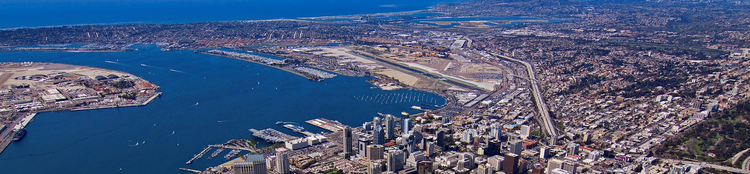
Master Hazard Insurance Review
(Condo Policy)

Slide 2
Introduction
This session will review the importance of how the Master Condo Policy needs to be handled for each loan.
1

Slide 3
Document Type
Evidence of Insurance or Declaration Page is required.
2

Slide 4
Borrower & Property Information
Borrower and Co-Borrower(s) must be reflected as well as the subject property address.
NOTE: 1. No name variations (I.E. Bob for Robert). Borrower Name(s) must match docs exactly.
2. Parties that are vested on Title but are not on the loan can be listed, but are not required.
3. Company names (Management Company) are not
allowed.*
NOTE: 4. Trusts are not allowed.*
*This does not apply to Mixed Use ODF & ODF+ loans.
3

Slide 5
Borrower & Property Information (Cont.)
5. Address must match the Subject Property as reflected in BytePro exactly. (Street type or directional indicators can be abbreviated, such as Ave., Blvd., NW, or SE.)
6. Exception for Areas, such as Area of Glendale, City of Los Angeles. Glendale or Los Angeles are acceptable as the Subject Property city.
4

Slide 6
Coverage
General Liability must be at least $1,000,000.00.
Fidelity Bond (Employee Dishonesty/Crime) must be at least $50,000.00.
Building must have blanket coverage for full replacement of the subject unit.
Deductible cannot exceed $10,000.00 or 1% of policy face amount.
HO-6 Dwelling Coverage must be at least 20% of the lesser of Reconciled/Reviewed Value or Purchase Price.
NOTE: 1. If policy includes Walls In Coverage, it must indicate including NOTE: Improvements and Betterments. (HO-6 will not be required)
NOTE: 2. If policy only covers common areas (No Building Coverage, a NOTE: 1. full HO-3 policy will be required.
NOTE: 3. Directors and Officers Coverage is not Fidelity Bond.
5

Slide 7
Mortgage Clause
Policy must reflect CSC as the Mortgagee with CSC Loan Number.
No other parties can be included.
Example:
Citadel Servicing Corporation, ISAOA
15707 Rockfield Blvd., Suite 320
Irvine, CA 92618
Ln. # 711XXXX
6

Slide 8
DV Upload Index
Master Condo Policy should be uploaded as Condo Master Policy. NOTE: 1.
HO6 Policy should be uploaded as HO6 Policy.
NOTE: 1. Any policy uploaded for any property other than the Subject Property should be uploaded as
TAX-HAZ-HOA Bill(s) for non-subject property.
2. Any policy that has been updated and is no longer
being used needs to be hidden.
7

Slide 9

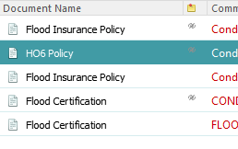
DV Upload Index
8

Slide 10
Any Questions?
?

